Slide 1

ODFAutoTests:
Creating automatic tests for ODF
Jos van den Oever

Slide 2
Who am I?
Jos van den Oever
Contributor to WebODF and Calligra
Co-chair of ODF Technical Committee for Dutch government
Working for Dutch government publishing PDF, ODF, Linked Data

Slide 3

ODF file formats
Four versions of the standard:
  ODF 1.0, ODF 1.1, ODF 1.2, ODF 1.2 extended
Stored as package or as xml
.odt, .odg, .odp, .ods, .odc, .odi, .odf, .odm, .oth, .odb
.ott, .otg, .otp, .ots, .otc, .oti, .otf
132 different types of ODF files
~600 element names
~1300 attribute names

Slide 4
ODF compliance according to ODF 1.2 specification
Types of ODF software
  OpenDocument Producer
  OpenDocument Extended Producer
  Consumer
Packed format required, XML optional
Must support at least one format
No rule on what elements and attributes should be supported

Slide 5
ODF interoperability
Two ODF implementations may be
Not interoperable at all because:
  Support different ODF document types (.odt vs .odp)
  Support different versions of ODF (1.1 vs 1.2)
Badly interoperable because:
  Implemented feature set varies
  Loading and saving is destructive
There is a need to document which applications work together for which document types and features.

Slide 6
ODF interoperability
Conformance to ODF 1.0, ODF 1.1, ODF 1.2, ODF 1.2 extended
Manual work
Actual testing takes up time at the plugfest
No way to automate the scenarios
Outcome dependent on who is participating in the plugfest

Slide 7
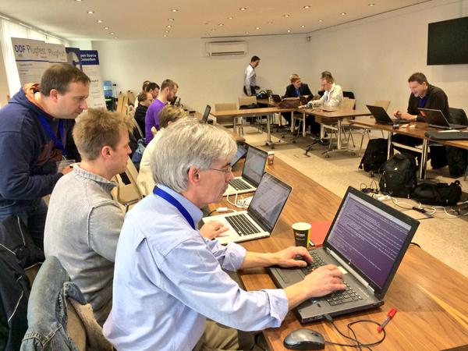
ODF scenarios
Tester perform a list of steps in the office suite
Manual work
Actual testing takes up time at the plugfest
No way to automate the scenarios
Outcome dependent on who is participating in the plugfest

Slide 8
Making a test document
Start with feature X
Make a content.xml or styles.xml with the feature
Zip it into a ODF document
Fiddle until the document is valid
Load and save
Unzip saved result and inspect it

Slide 9
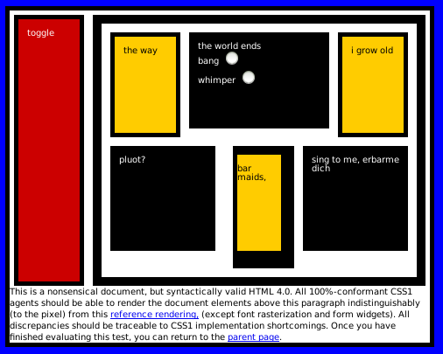
Box Acid Test (Acid1)
1998
Todd Fahrner
CSS 1

Slide 10

Acid2
April 2005
Ian Hickson
CSS 2.1
HTML
PNG
Safari passed in October 2005
Opera, Konqueror, Firefox followed soon
In 2009, Internet Explorer 8 passed

Slide 11
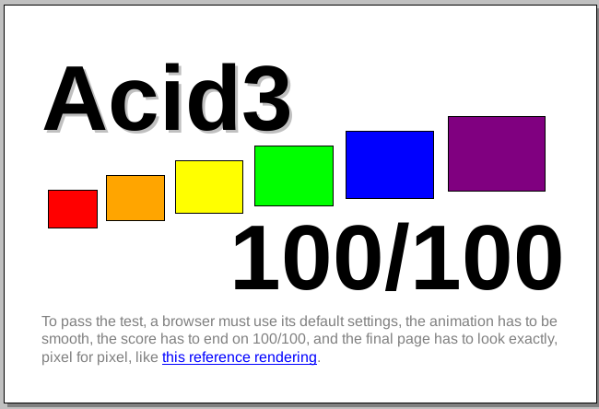
Acid3
March 2008
Ian Hickson
DOM
JavaScript
SVG
Embedded fonts
In 2010, WebKit and Firefox pass
In 2012, Internet Explorer 10 passed
Mobile browsers mostly pass

Slide 12
Acid tests for ODF
HTML is read-only, ODF is read / write
ODF has no standardized scripting language
ODF is usually not a text file, but a zip file

Slide 13

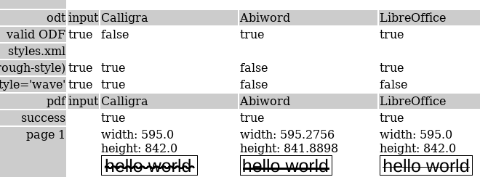
OdfAutoTests
Provide a small snippet as input
Run through a collection of office suites
Summarize the output and show example renderings

Slide 14
Example test
<test name="simpletext">
<input type="odt1.2">
<o:text>
<text:p>hello</text:p>
</o:text>
</input>
<output types="odt1.0 odt1.1 odt1.2 odt1.2ext">
<file path="content.xml">
<xpath expr="count(//o:text/text:p)=1" />
</file>
</output>
<pdf/>
</test>

Slide 15
What is output?
Was the file loaded and saved correctly?
Is the output valid ODF?
What does the input snippet look like after loading and saving?
How long did loading and saving take?
The results of the XPath expressions
Generated PDF and PNG renderings of that

Slide 16
Plugfest
visit http://vandenoever.info/tmp/2015/
Browse through test
Pick one, vote one one
Discuss if it is a real bug in an application, if so put in the Plugfest report

